Slide 1

ONLINE MOVIE TICKETS BOOKING
NMS CINEMA

Slide 2

A project PRESENTATION on ONLINE MOVIE TICKET BOOKING Presented By : Group:- 07
Name | ID
SHUBHAM KAMTHE | 2487704
SAURABH BRAHASPATI | 2486516
SHARADDHA IRALE | 2484352
SHEEBA FATIMA | 2483847
BHARATH KUMAR SEGGAM | 2487456
SHAHBAZ AINARKAR | 2485040
SHAIK MOHAMMAD ISMAIL | 2487709
SIDDESHA H P | 2487653
SHAIK ABDUL RIYAZ | 2486661
SAI MAHESH SATULURI | 2485352

Slide 3

Introduction :
The traditional way of booking the ticket for the movie is the customer need to go to the specific theatre where the desired movie was playing and need to stand in queue and buy the ticket for the movie this will become more difficult for a person in order to overcome this problem
The project gives real life understanding of online movie ticket booking system and activities performed by various roles in the supply chain. Here we provide automation for movie ticket booking system through internet. Online movie ticket booking system project captures activities performed by different roles in real life ticket booking which provides enhanced techniques for maintaining the required information up to date, which results in efficiency. The project gives real life understanding of online movie ticket booking system and activities performed by various roles in the supply chain.

Slide 4
Background of the Project:
NMS Cinemas is a chain of single screen theatres that screen movie shows of different genres and languages at very genuine prices. It was established in 2004 in Pune, India. Recently, the business analysts noticed a decline in sales since 2010. They found out that the online booking of movie tickets from apps, such as BookMyShow and Paytm were gaining more profit by eliminating middlemen from the equation. As a result, the team decided to hire a Full Stack developer to develop an online movie ticket booking web application with a rich and user-friendly interface. You are hired as the Full Stack Java developer and are asked to develop the web application. The management team has provided you with the requirements and their business model so that you can easily arrange different components of the application

Slide 5

Tools and Technologies:
Front End: Angular 13/HTML/CSS
Server-Side: Spring Boot
Backend: MySQL , Hibernate
Server: Tomcat
Operating System: Windows 10/11
Developing Method: Agile Methodology

Slide 6
User Role:
Register
Register to the application
Sign In
Sign into the application to maintain the record of activities
Apply
Apply filters and sort results based on different genres
Experience
Experience a seamless payment process.
Receive
Receive a booking summary page once the payment is complete.
Search
Search for movie shows based on the shows currently airing

Slide 7
Admin Role:
Login to portal
Add or remove different genres to or from the application to build a rich product line.
Edit movie details like name,banner,language, description to keep it aligned to the current prices.
Enable or disable movie shows.
Delete the movies.
View different genres.
Add Theatre and Edit Accordingly

Slide 8
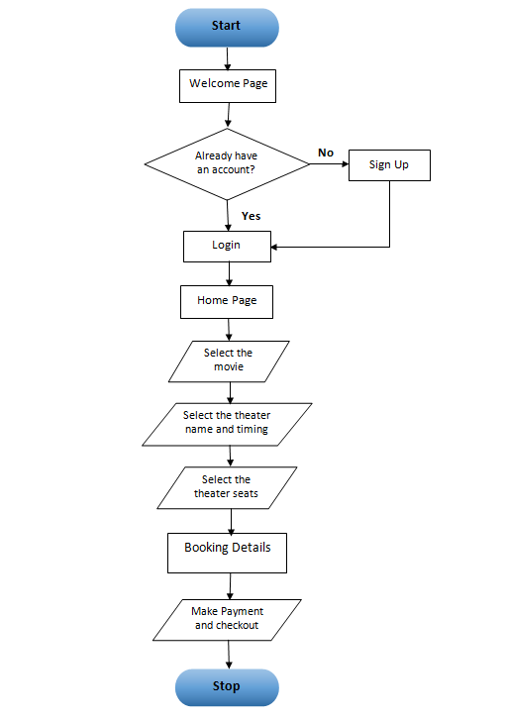
Flow Chart:

Slide 9
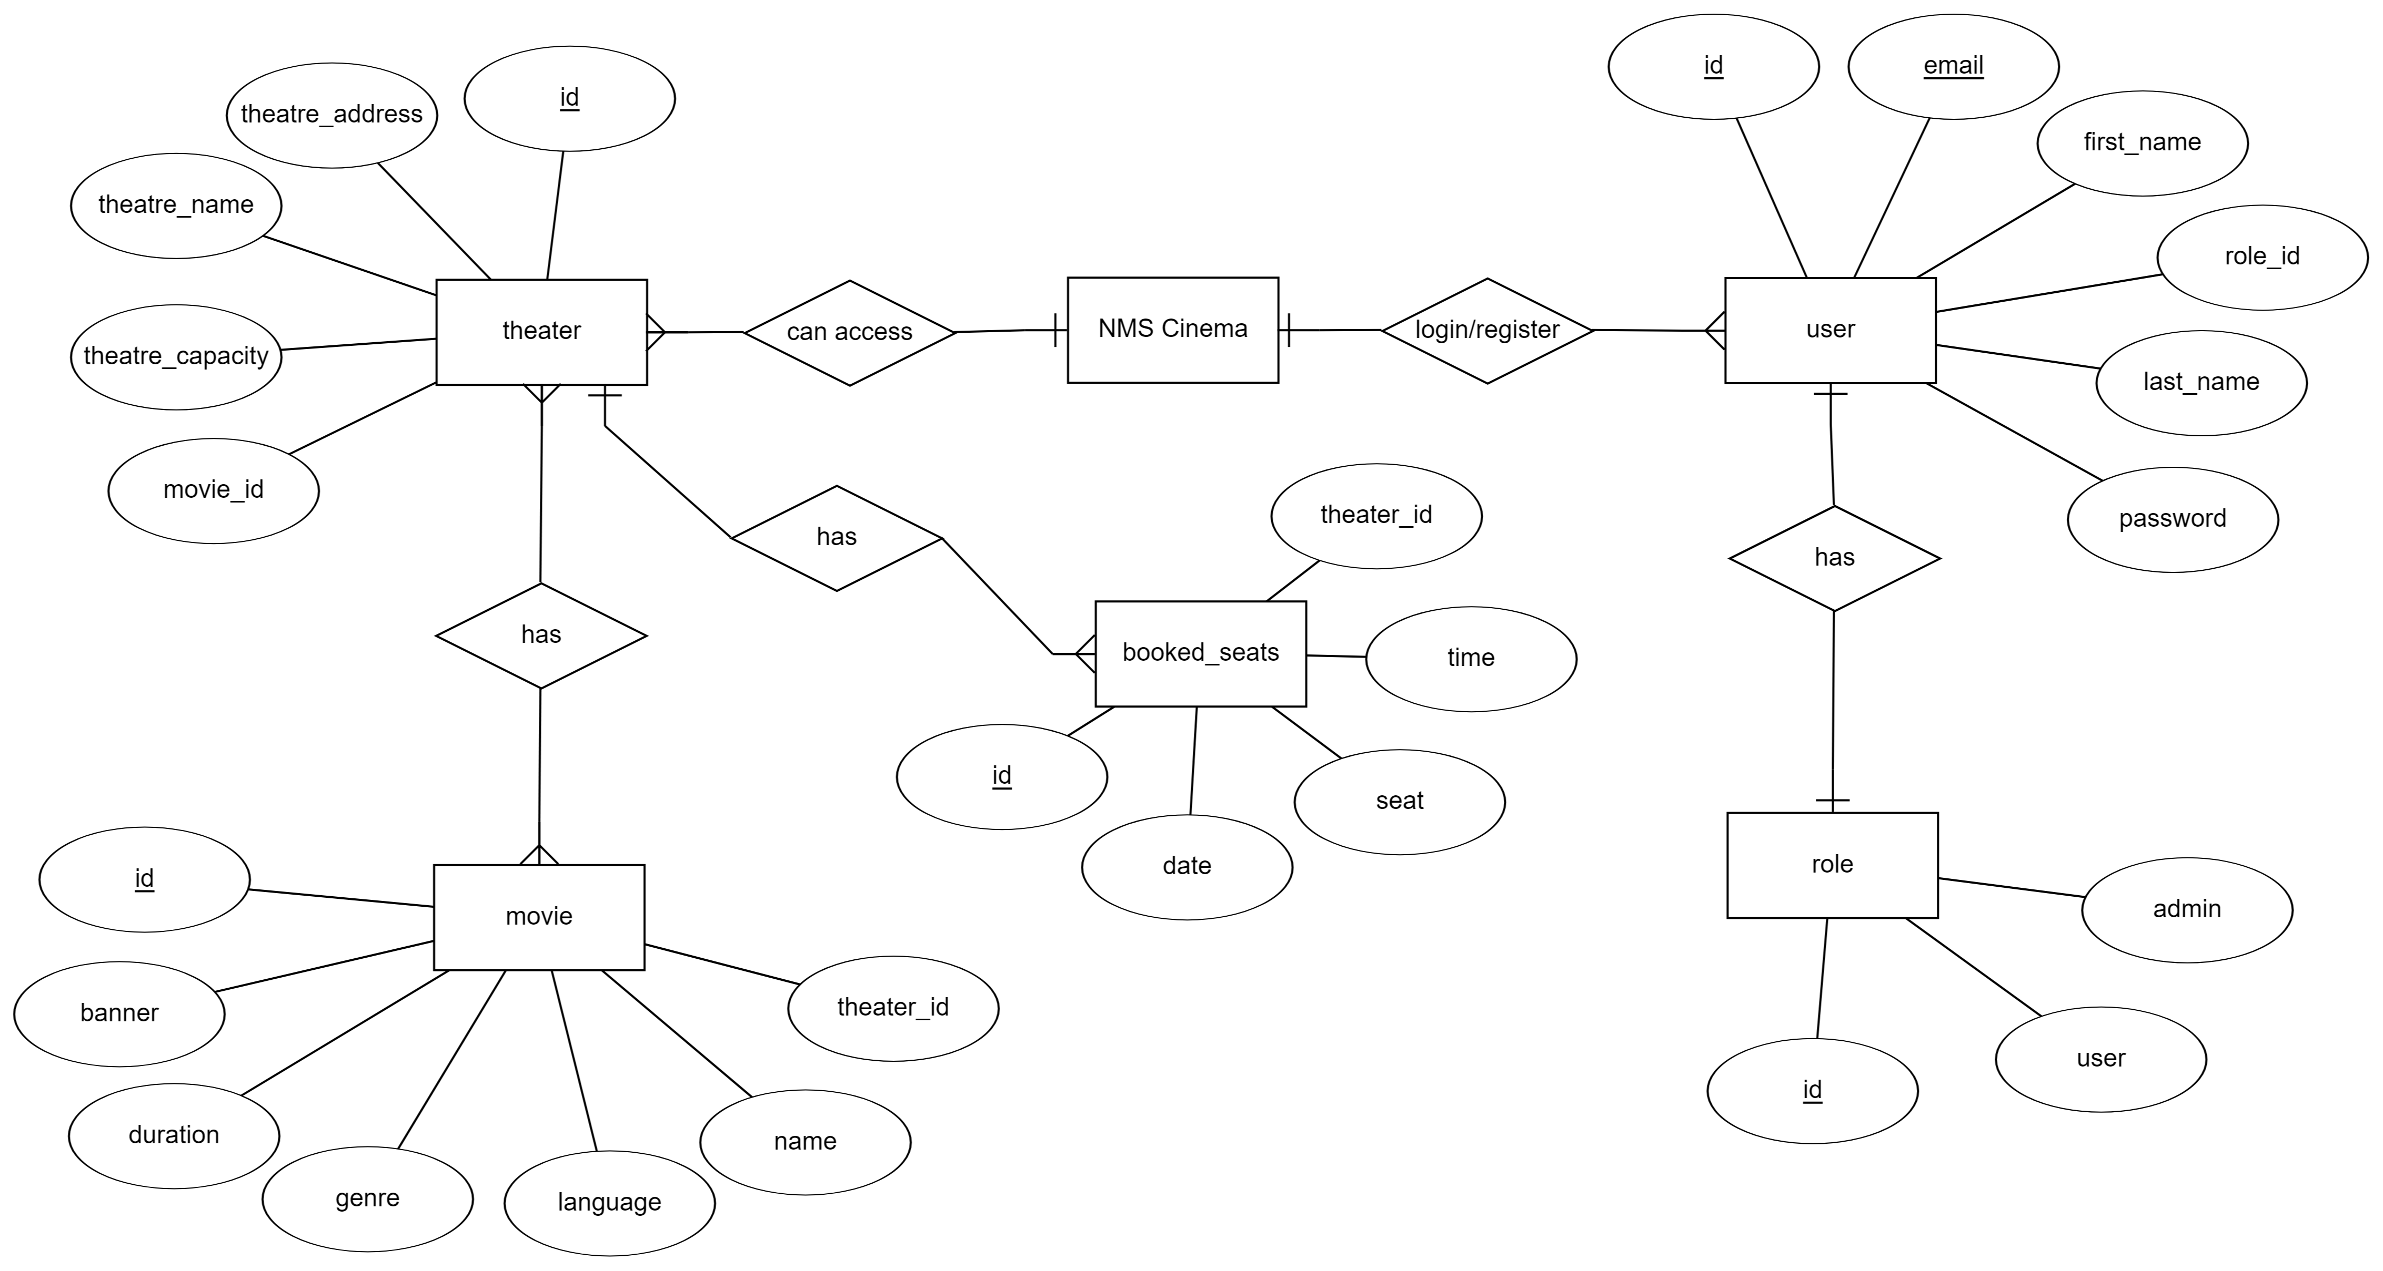
ER-Diagram

Slide 10
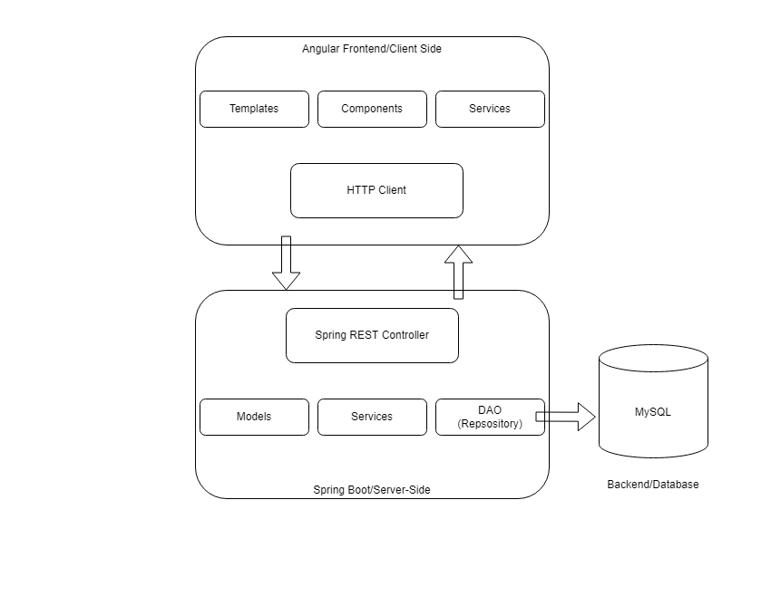
Model Used:

Slide 11
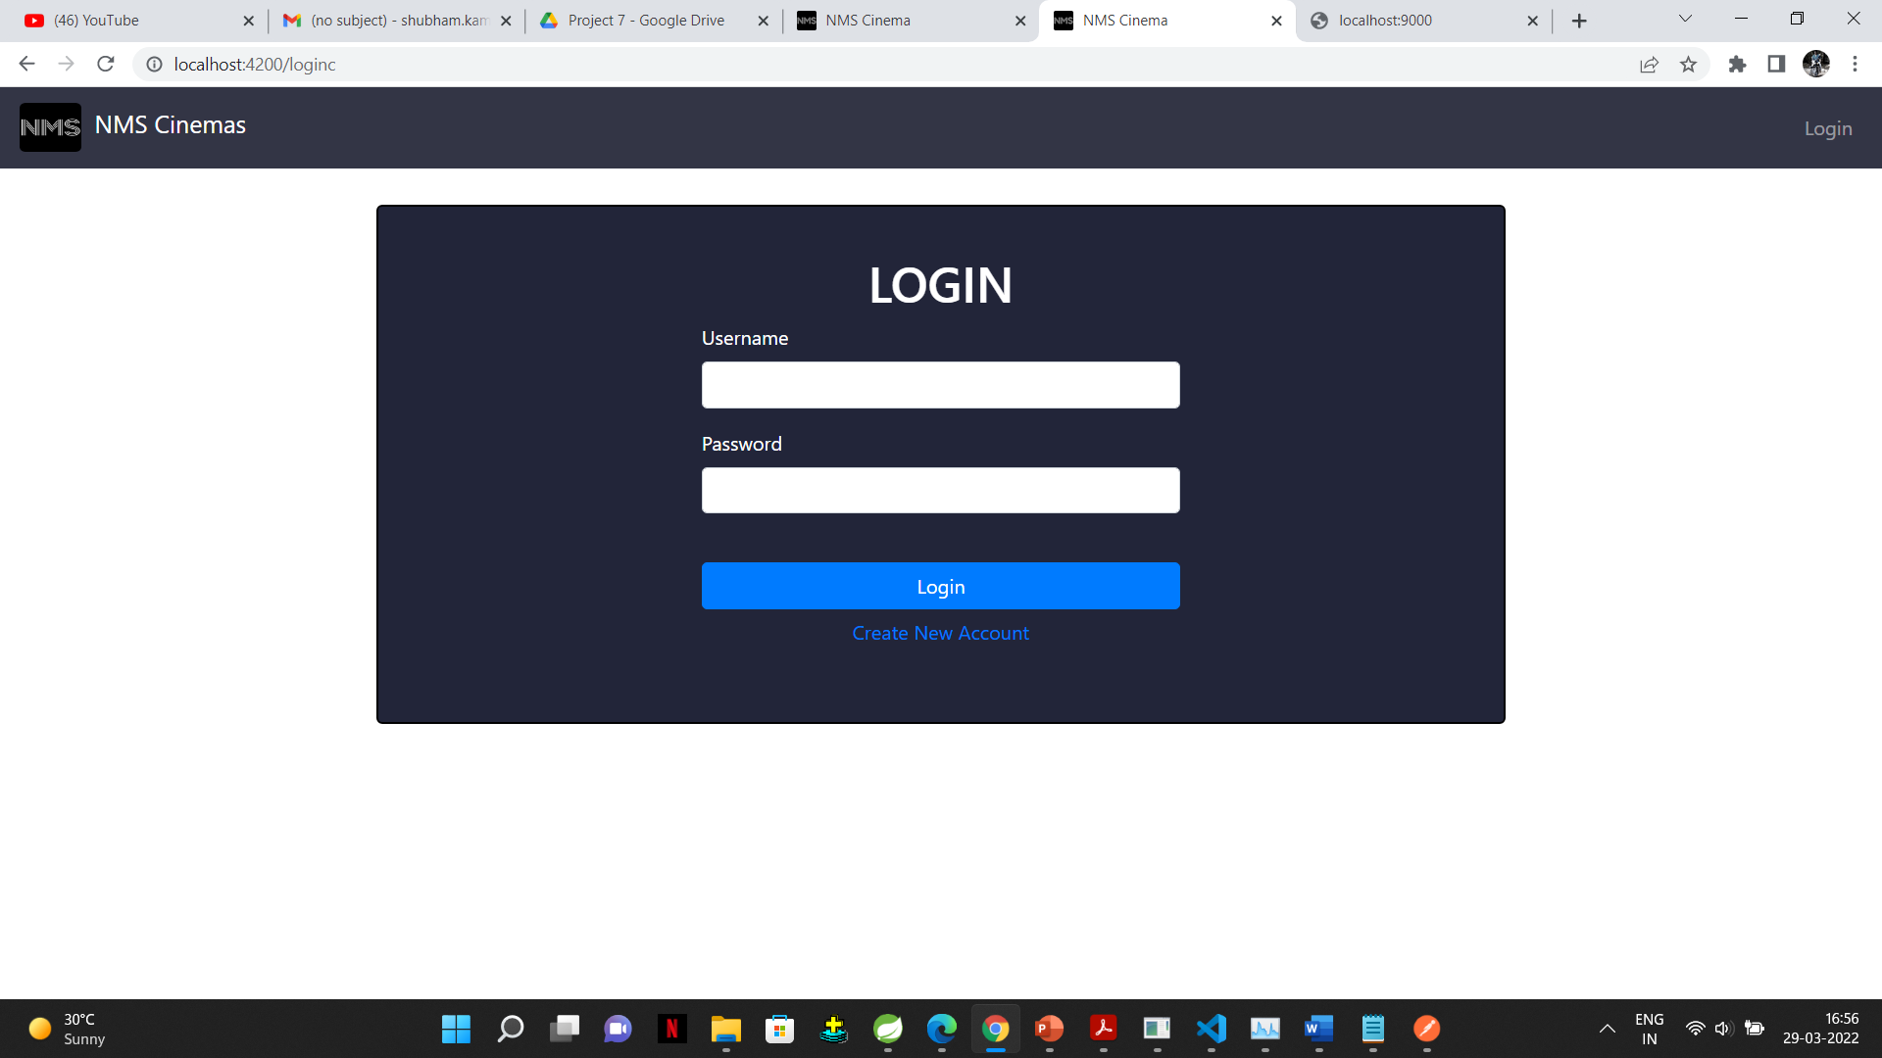
Login Page:

Slide 12
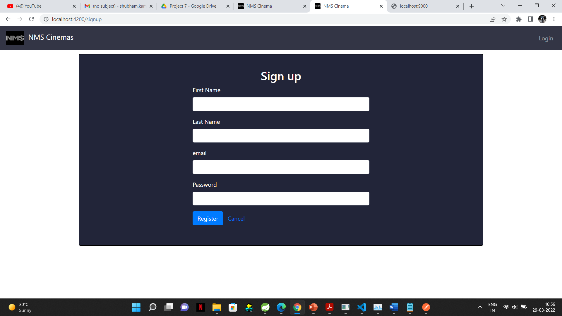
Registration Page:

Slide 13
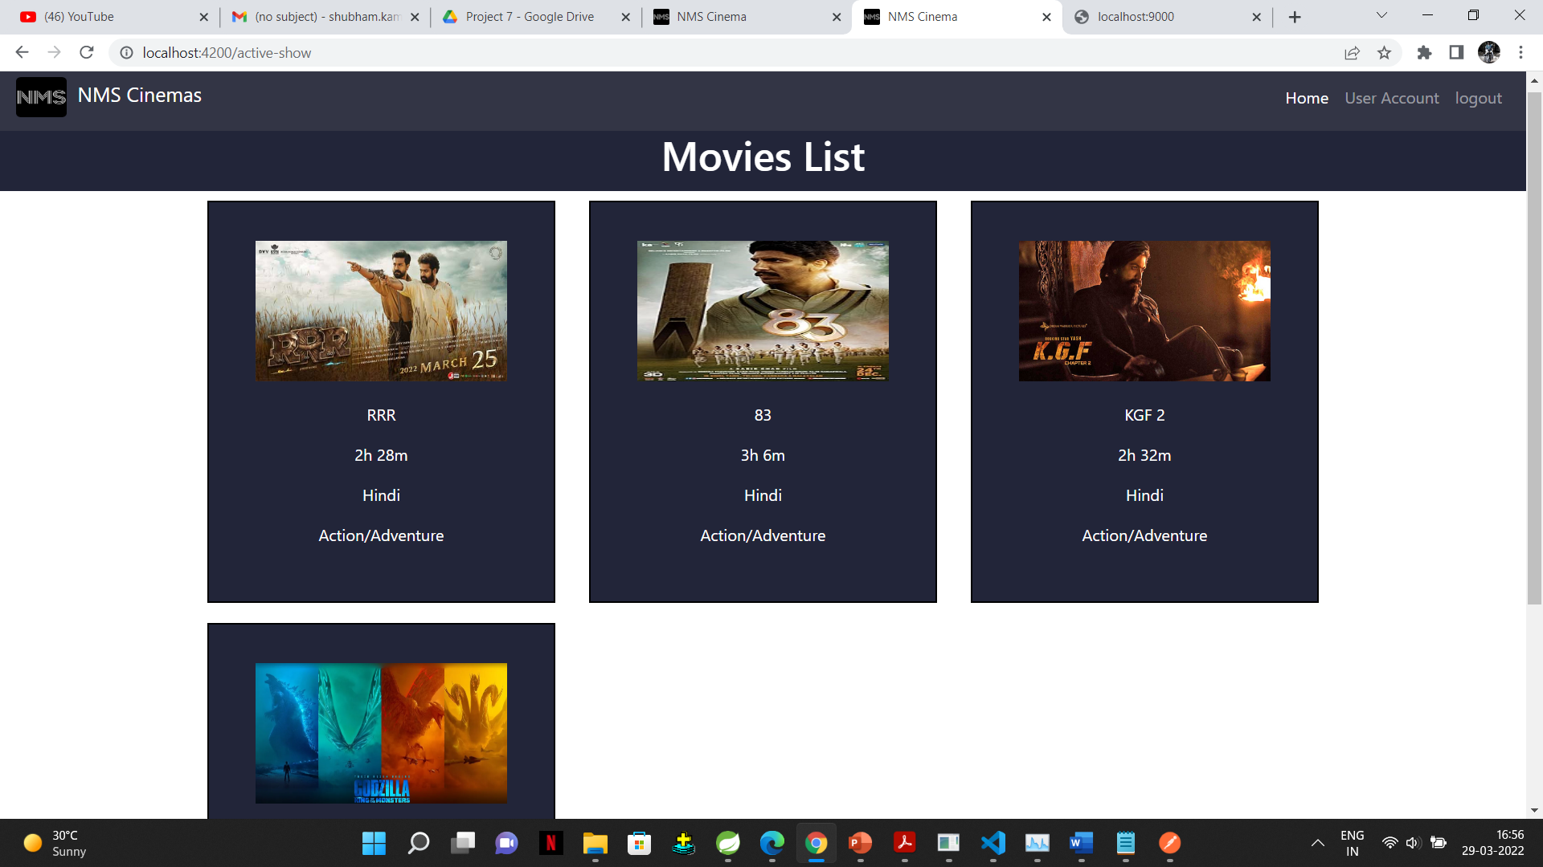
Home Page:

Slide 14
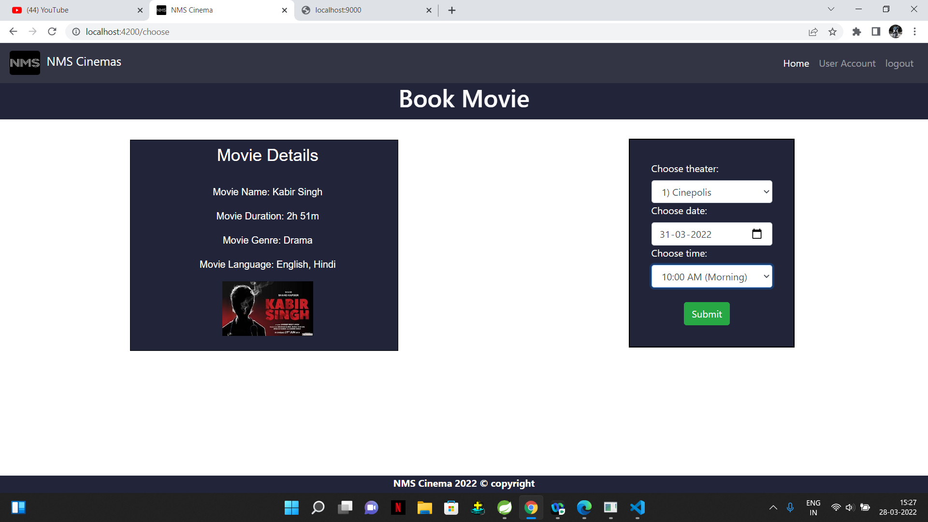
Choose/Book Movie:

Slide 15
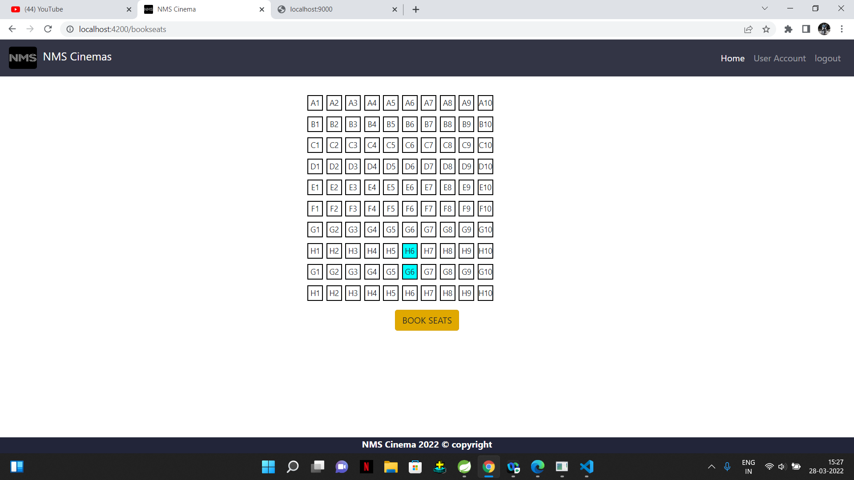
Select Seats:

Slide 16
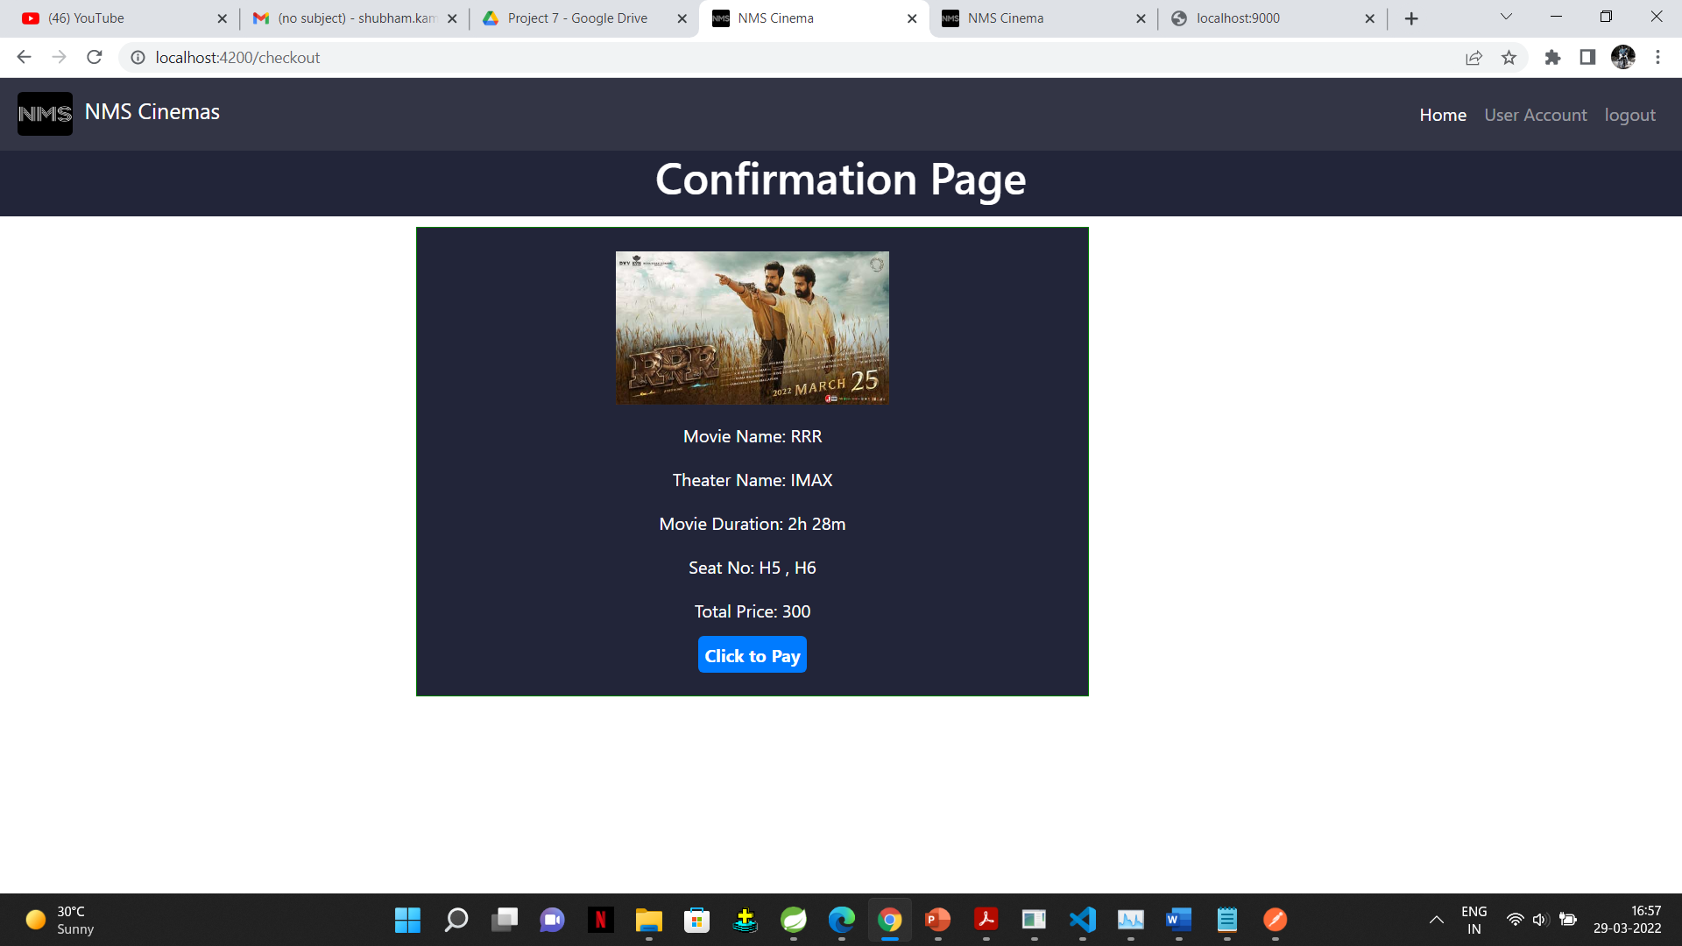
Confirmation Page:

Slide 17
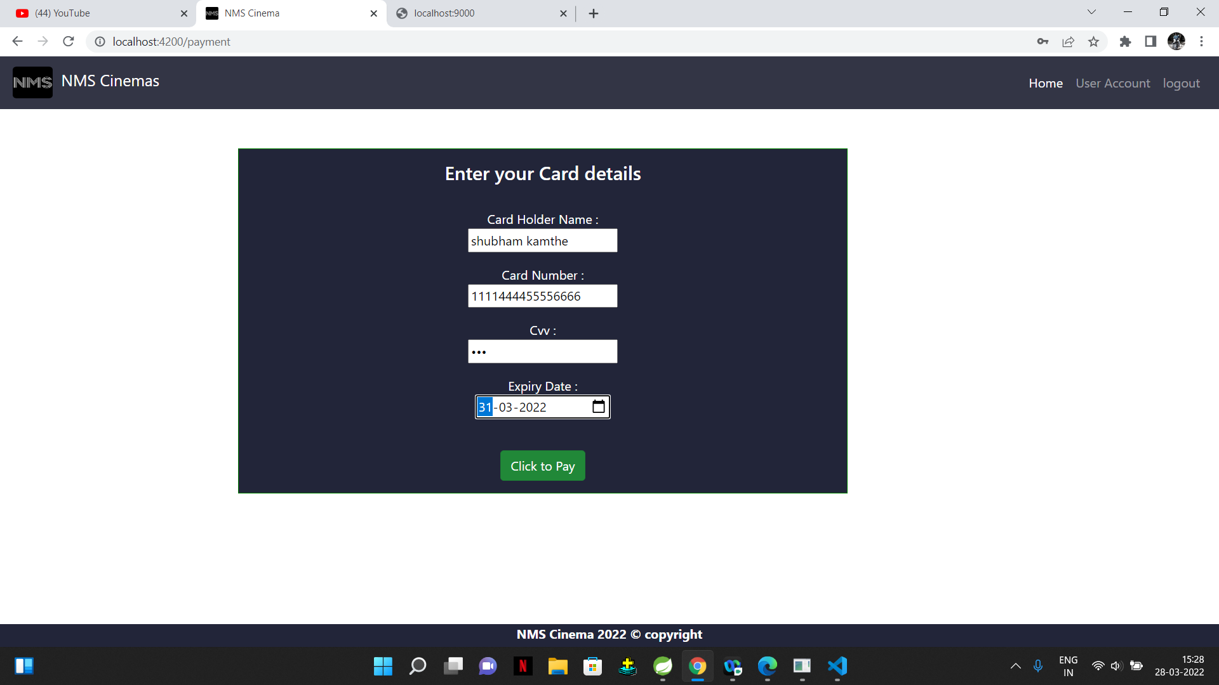
Payment Page:

Slide 18
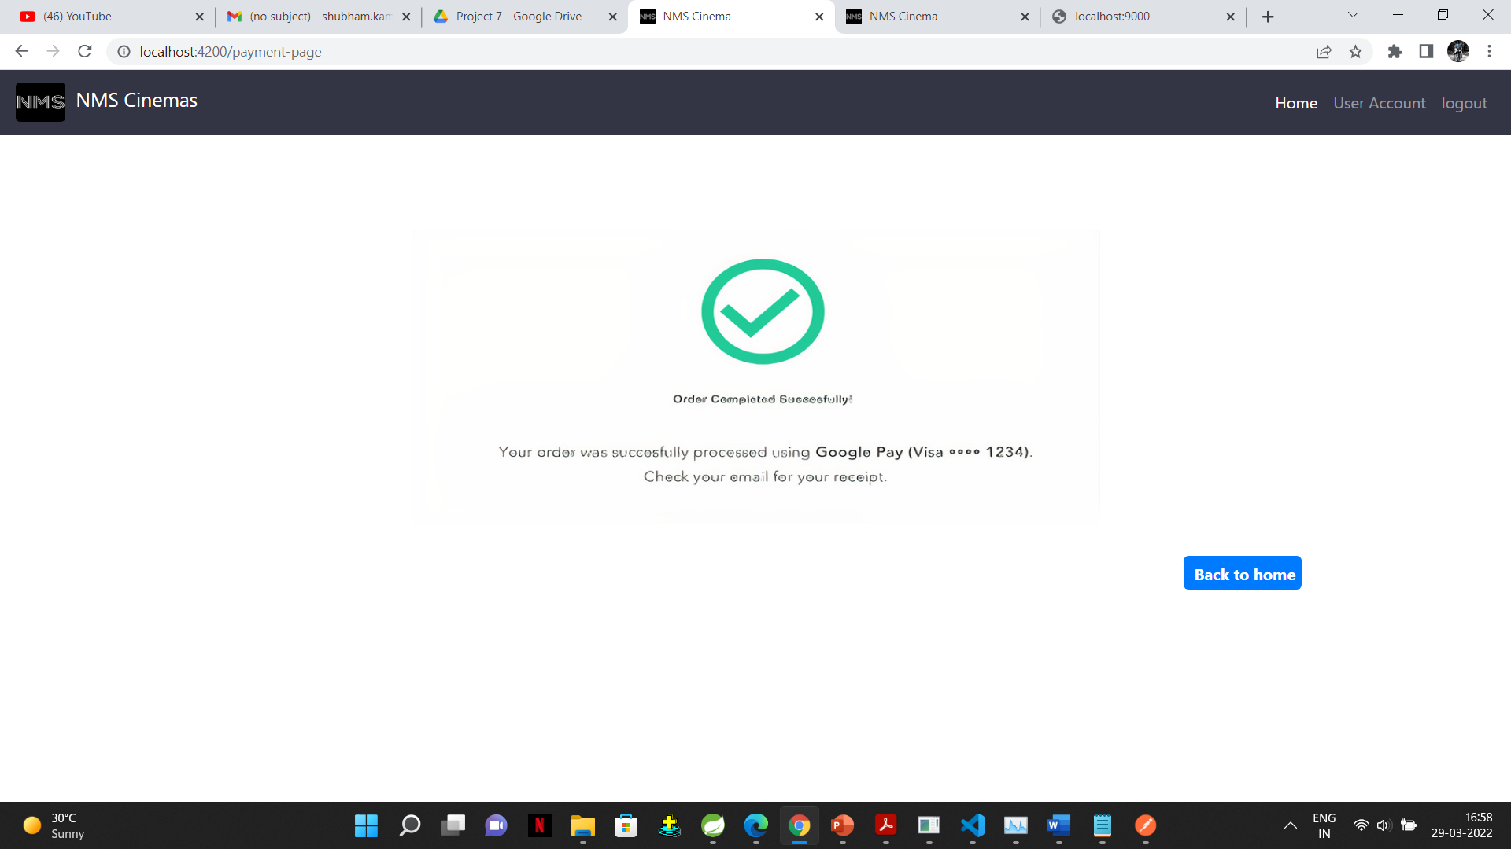
Success Page:

Slide 19
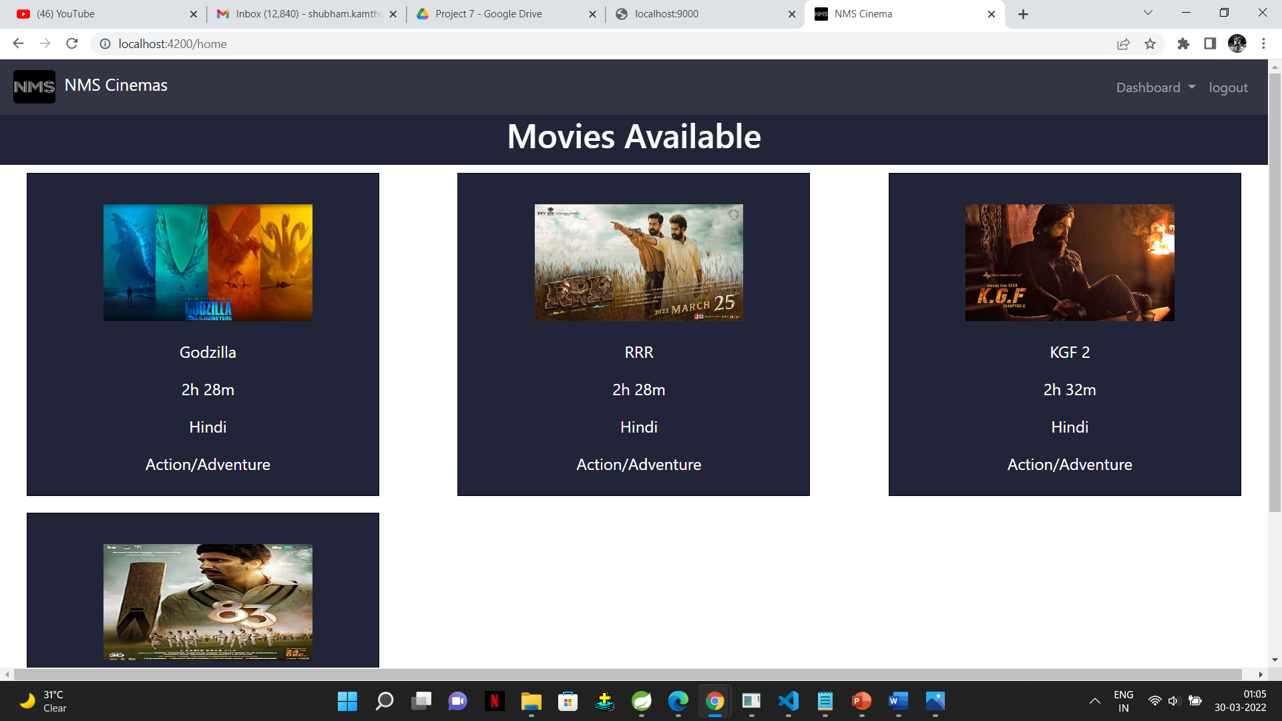
Admin Login:

Slide 20
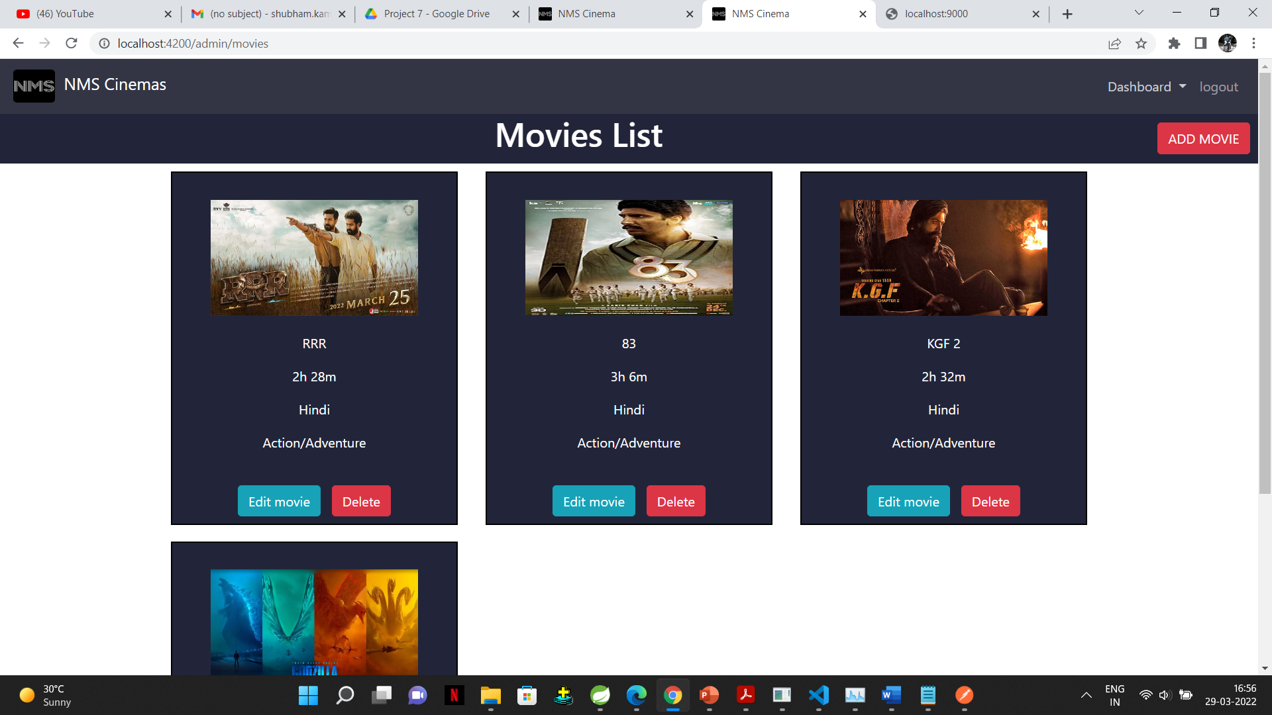
Add Movie:

Slide 21
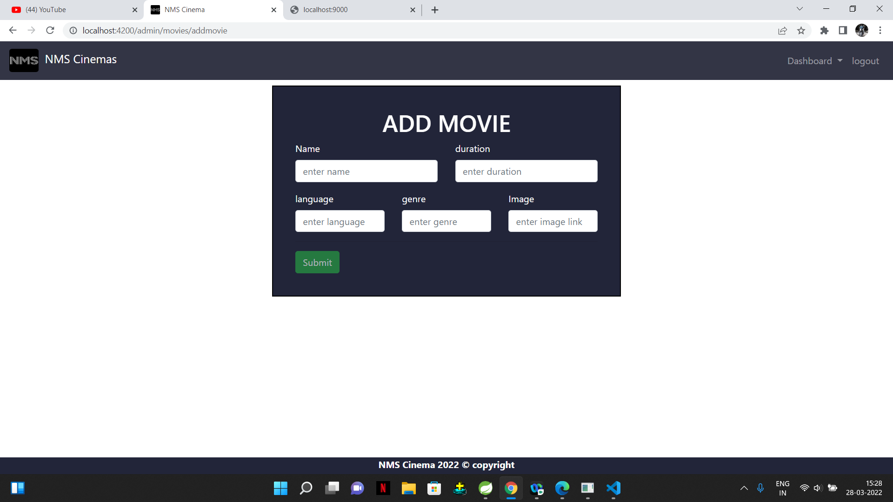
Add Movie

Slide 22
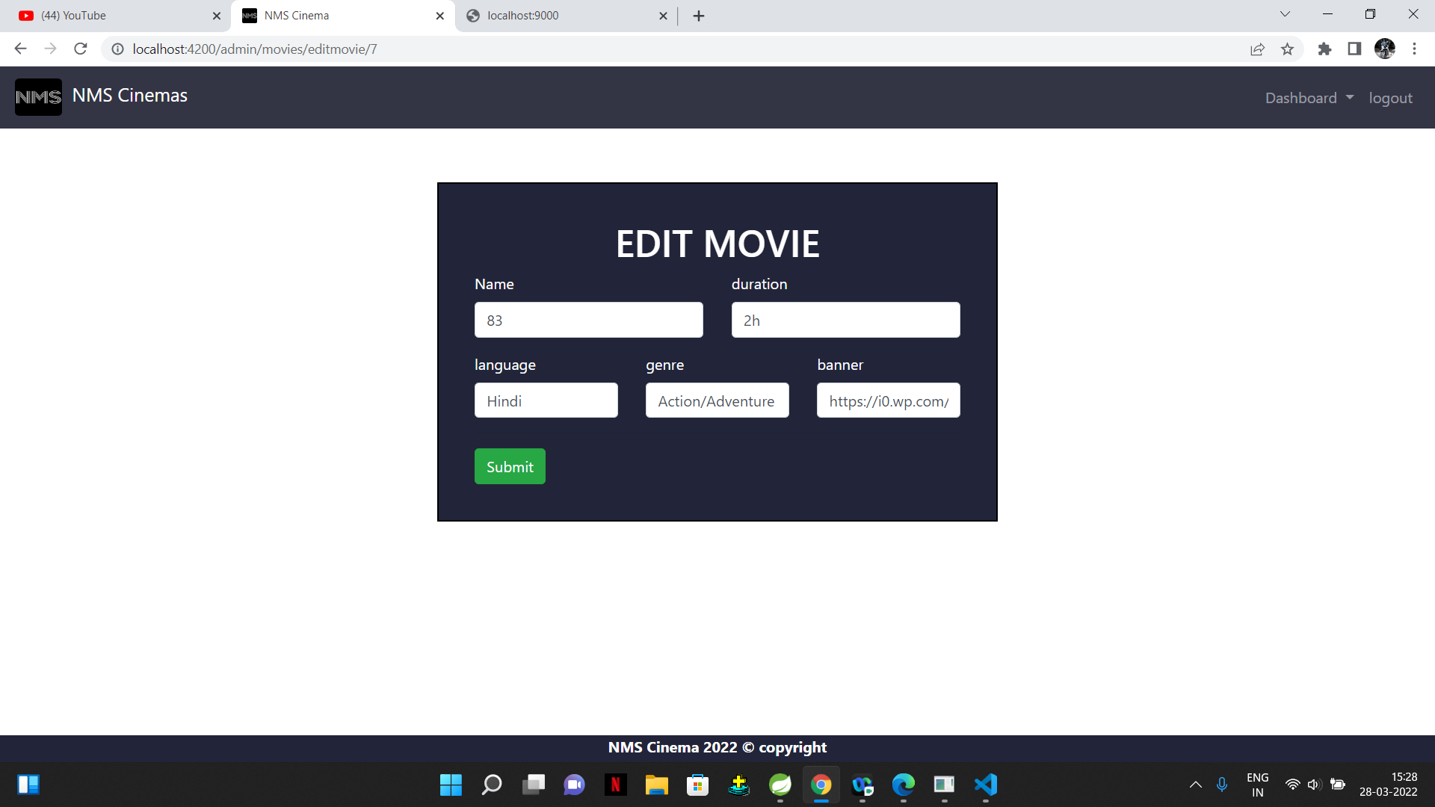
Edit Movie:

Slide 23
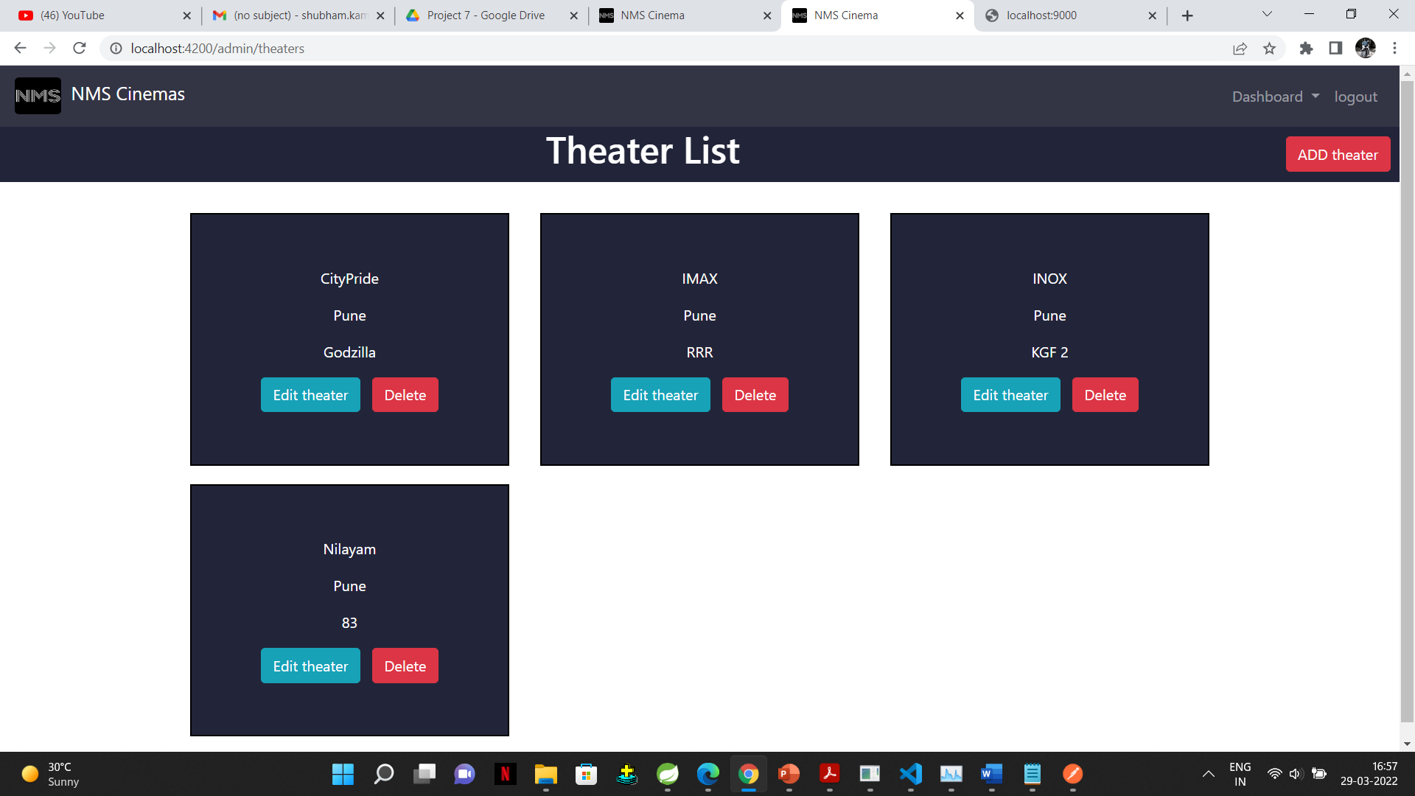
Add Theatre

Slide 24
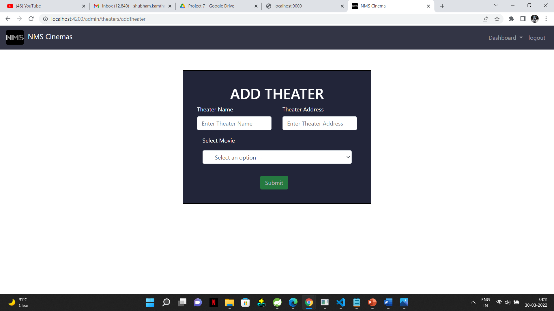
Add Theatre:

Slide 25
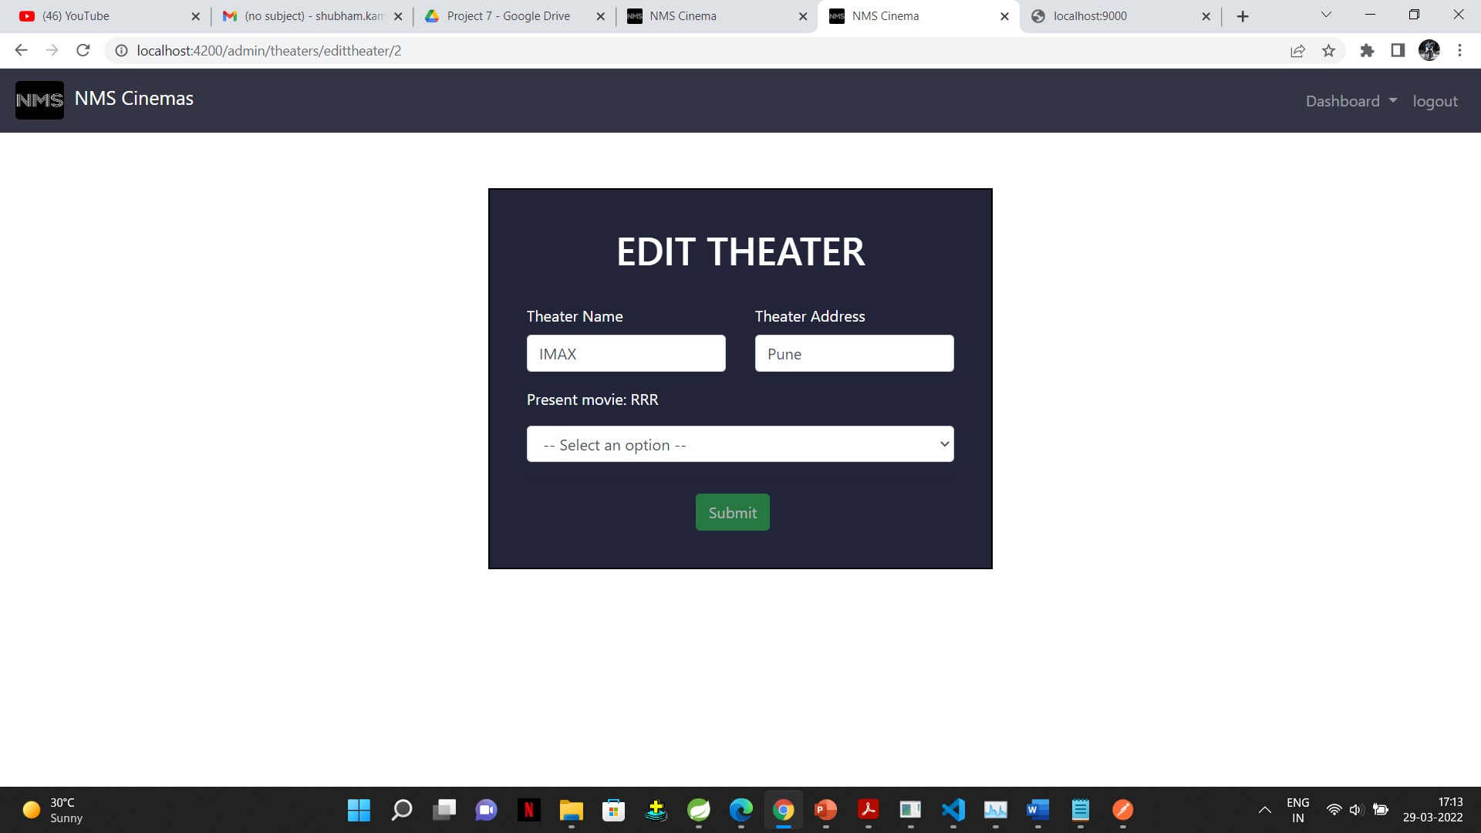
Edit Theatre:

Slide 26

Conclusion:
ONLINE MOVIE TICKET BOOKING is the ticket booking service that allows the customers to book the movie tickets on the computerized networks such as internet through secure website with a particular movie booking system, which has resulted from the blossoming Internet technology, obviously has many benefits for the user by getting the entertainment without wasting the time by standing in queue for hours and hours.

Slide 27

Thank you!

